Slide 1
Grad rehearsal 2024
Notes:
NOTE:
To change the image on this slide, select the picture and delete it. Then click the Pictures icon in the placeholder to insert your own image.

Slide 2
Agenda
Thanks Chef Smith and Chef Karen (and staff volunteers)
Dinner/Dance and Dry Grad Details
Ceremony Details
BREAK
Overview of processional
Rehearsal of processional (we’ll move to the gym)
[Brief] rehearsal of “walking”
Rehearsal of recessional
Obtain grad attire and tickets

Slide 3
YOUR STAFF GRAD COMMITTEE
A LOT OF WORK AND TIME goes into making your grad events run successfully.
We do this because we want to, but a thank you at some point over the next few weeks goes a long way, too.
Your administrators
Ms. Fisher (dinner/dance)
Ms. Preddy (dinner/dance)
Ms. Dimmock (emcee)
Mr. Biggar (emcee)
Ms. Gloslee (money)
Ms. Chessa (student records and a whole bunch of other stuff)
Ms. Gilbert (a whole bunch of stuff, including reminding most of us what we need to do)
About 20 other staff who help us at the ceremony

Slide 4
Dinner/Dance
Friday, June 7 @ Meadow Gardens
Arrival @ 6:00
Take family pictures BEFORE arrival; families are to drop off only
Parking will be a challenge
It is very busy and there are lots of people
Limited access to outdoor spaces (especially if it rains)
Grads move to assigned tables @ approx. 6:30/6:45, followed by toast to the grads TBA and then dinner

Slide 5
Dinner/Dance (cont’d)
You will receive a ticket (or tickets if you have a guest) today; they are NUMBERED. You need to have YOUR TICKET to get in.
THIS IS A SCHOOL EVENT; please conduct yourselves accordingly
You cannot go upstairs
There is lots of space to take photos with friends and teachers, but PLEASE STAY OFF THE GREENS
Smoking/vaping: designated outdoor areas only, please

Slide 6
QUESTIONS ABOUT THE DINNER/DANCE?

Slide 7
Dry Grad
Friday, June 7 @ THSS
11:30 start time; must enter by 12:00 (or make arrangements)
Enter via gym doors
Wear comfortable clothes
You should have a safe way home (i.e. not driving after you’ve been up all night)
Make sure you’ve submitted your waivers for bull/surfboard (available in the office; guests need one, too)
You will also have a ticket/tickets for this event; these tickets are ALSO NUMBERED

Slide 8
Dry Grad (cont’d)
Events from 11:30 – 2:00
mechanical bull & mechanical surfer (waiver forms req’d)
Karaoke – in Mr. Dickin’s media room by the rotunda
Casino – in the rotunda (grads will receive “grad bucks” when they arrive)
Sumo wrestling, bungee run/bungee basketball, jousting, obstacle course, “horse” racing – in the gym
Tattoos – hallway outside rotunda
Giant Jenga and connect four games – hallway outside rotunda
Magician - rotunda
Foosball & air hockey – hallway outside rotunda
Food (pizza, chips, ice cream, pop, candy, etc.) – at the cafeteria

Slide 9
Dry Grad (cont’d)
2:30 – 3:45
Hypnotist show – in the gym
3:45 – 4:00
Major draw prizes. You must be present to win.
Questions? Ask Mr. Radom

Slide 10
QUESTIONS ABOUT DRY GRAD?

Slide 11
Grad Ceremony: Arrival
Thursday, June 6 @ The Queen Elizabeth Theatre
Arrival at the theatre for grads is 5:45
You may want to get to Vancouver earlier to avoid traffic, have a bite to eat (you won’t even be out of the theatre until at least 9:30)
Main parkade on Cambie St (underground); the one across the street is no longer there
There are other parkades nearby, as well as some street parking

Slide 12
Grad Ceremony: Tickets
You will receive tickets today (numbers don’t matter for these)
Each student will receive 9 tickets, including one for yourself (unless you’ve requested extras)
YOU NEED A TICKET TO GET IN. It’s a thing.
If you need more tickets, just see me/message me on Teams

Slide 13
Ticket Envelopes
When you get to the gym, your grad attire and ticket envelopes will be on your seat
In your ticket envelope:
9 tix for ceremony (more if you already requested from me)
Ticket for you (and guest) for dinner dance [if you paid for this event]
Ticket for you (and guest) for dry grad [if you paid for this event]
PLEASE DO NOT OPEN THIS ENVELOPE IN THE GYM
If there are issues, let me know please. Please don’t go to the office.

Slide 14
Grad Ceremony: Call Times
Students enter via Hamilton St entrance @ 5:45
Make your way upstairs to the 3rd floor of the lobby (staff will show you where to go)
Doors for parents @ 6:00 via Hamilton entrance
Interior doors (to the theatre itself) @ 6:30
General seating (but basically all seats are good)
Lots of mobility seating if needed (see me/message me if you haven’t already)
Ceremony starts @ 7:00
Ceremony runs approximately 2.5 hours

Slide 15
Grad Ceremony: Attire
Today you will receive your grad attire
Package should contain: gown, hood, cap, tassel
CHECK THAT THESE THINGS ARE THERE AND TRY ON THE GOWN AND THE CAP (at home)
Steam your gowns prior to the ceremony; very cool iron if needed
PLEASE don’t lose your tassel. We have a few extras, but only a few

Slide 16
Grad Ceremony: Attire (cont’d)
Wear light, semi-formal clothing underneath (it’s hot in there)
Something with a pocket for your phone? Or do you need your phone?
No pocket? Fanny pack UNDERNEATH…maybe the only time it’s a good idea to wear a fanny pack.
Sensible shoes (a lot of walking, a lot of people, a lot of stairs AND a lot of unevenly spaced stairs)

Slide 17
Grad Ceremony: Attire (cont’d)
Gown should be fully zipped up
Tassel should be on right front of hat (you will all move to the left at the same time after everyone has graduated)
Pointy part of hood should be flush with neckline of gown

Slide 18
Grad Ceremony: The About-To-Cross the Stage Bit
Very soon, we will practice the processional (entering the theatre)
[Once you’re in the theatre…]
You will then be seated in the rows at the front centre of the audience
When it’s time, your row captain will be tapped on the shoulder by Ms. Vanderpauw or Ms. Gray
Your row will get up (remaining in order) and proceed to side stage before you cross

Slide 19
Grad Ceremony: Folios (Folders)
At side stage, you will be handed your folio. It’s a folder, but “folio” sounds classier.
DON’T EVEN LOOK IN THERE AT THAT TIME. FOCUS.
This is what’s in there (spoiler: most of this isn’t interesting anyways):
grad composite photo
fake Dogwood certificate
letters of congratulations from the MLA and MP

Slide 20
Grad Ceremony: Folios (cont’d)
Later in June, you will be notified when you may come to the office to pick up an envelope containing:
Your photo(s) w/ Mr. Rowell from the ceremony
info re: any district scholarships you’ve won
certificates for any subject awards you have won
Real Dogwoods arrive at our school in late-Aug/early-Sept
You will be notified via your personal email address that you gave your CLC teacher (make sure you’ve done this)
At that time (September onward), you can come and pick up your Dogwood at the office (and your envelopes if you didn’t pick them up in June)

Slide 21
Grad Ceremony: Walking the Stage
Anyways, you’ve got your folio… [Demo on how to hold it]
You will be side stage until Mr. Biggar or Ms. Dimmock read your name
You will then begin to WALK across the stage to Mr. Rowell where you will pose for a photo
REMAIN THERE until your grad message and any awards and/or scholarships are finished being read out
Mr. Carriss and Mr. Ishani will point you to/be at the stairs to give you a hand down if you need

Slide 22
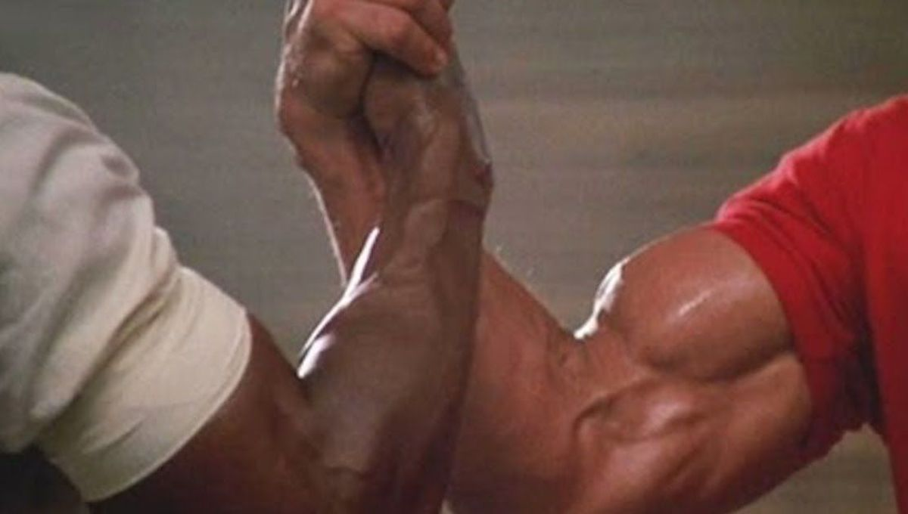
Handshake OR Fist Bump with Mr. Rowell…
Declare early (halfway or so across), otherwise it’s awkward

Slide 23
Grad Ceremony: Processional (entering the theatre)
After the upcoming break, you are about to be arranged into lines in alpha order
Each line represents one row of seating in the theatre
Before you go for break, stack chairs please
When you return from break:
Surname A on my left (rotunda closest to gym hallway side)
Surname Z on my right (rotunda closest to outdoor area)
Surname M in the middle(ish)
Etc.

Slide 24
please return promptly in 10 minutes and arrange yourselves per my SUPER clear instructions

Slide 25
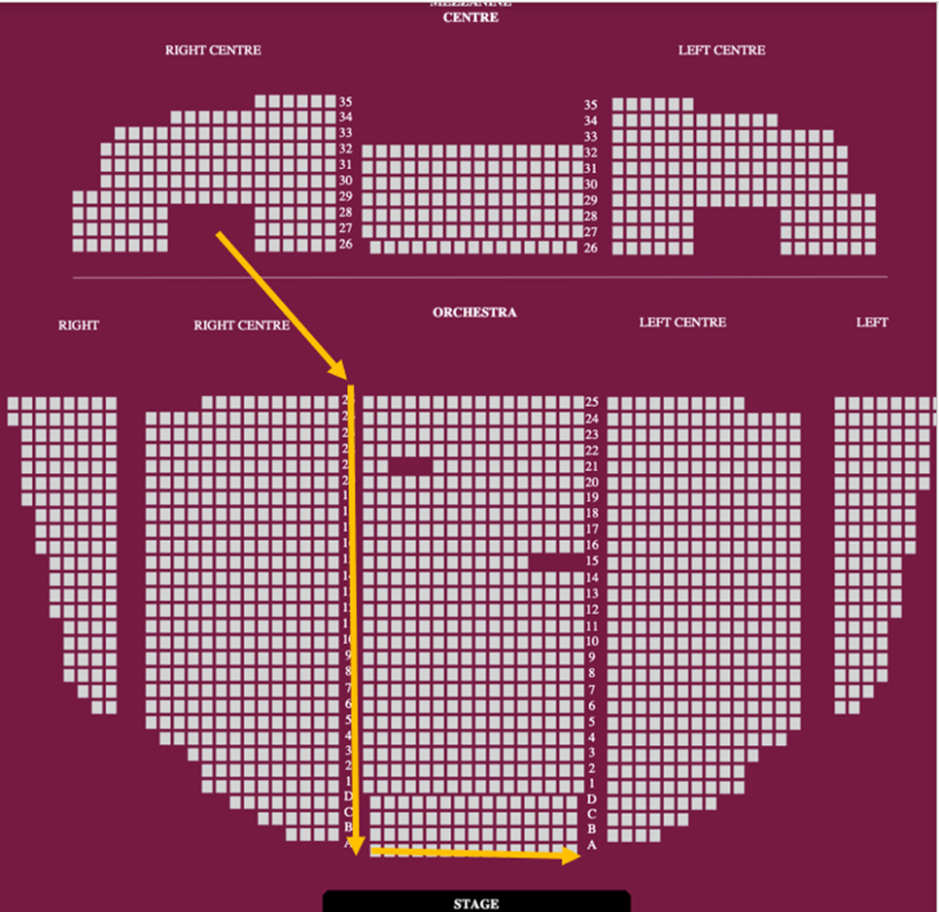

Slide 26
ROW TIME.

Slide 27
Processional
Review: when you get to the QE, you’re heading upstairs to find your row.
Before you do, ditch anything you don’t need with your family. Do you need your phone?
When you get up there, find your row. Know where it is.
Once you have, you can move around BUT STAY UPSTAIRS.
Use the bathroom. It’s gonna be a while…

Slide 28
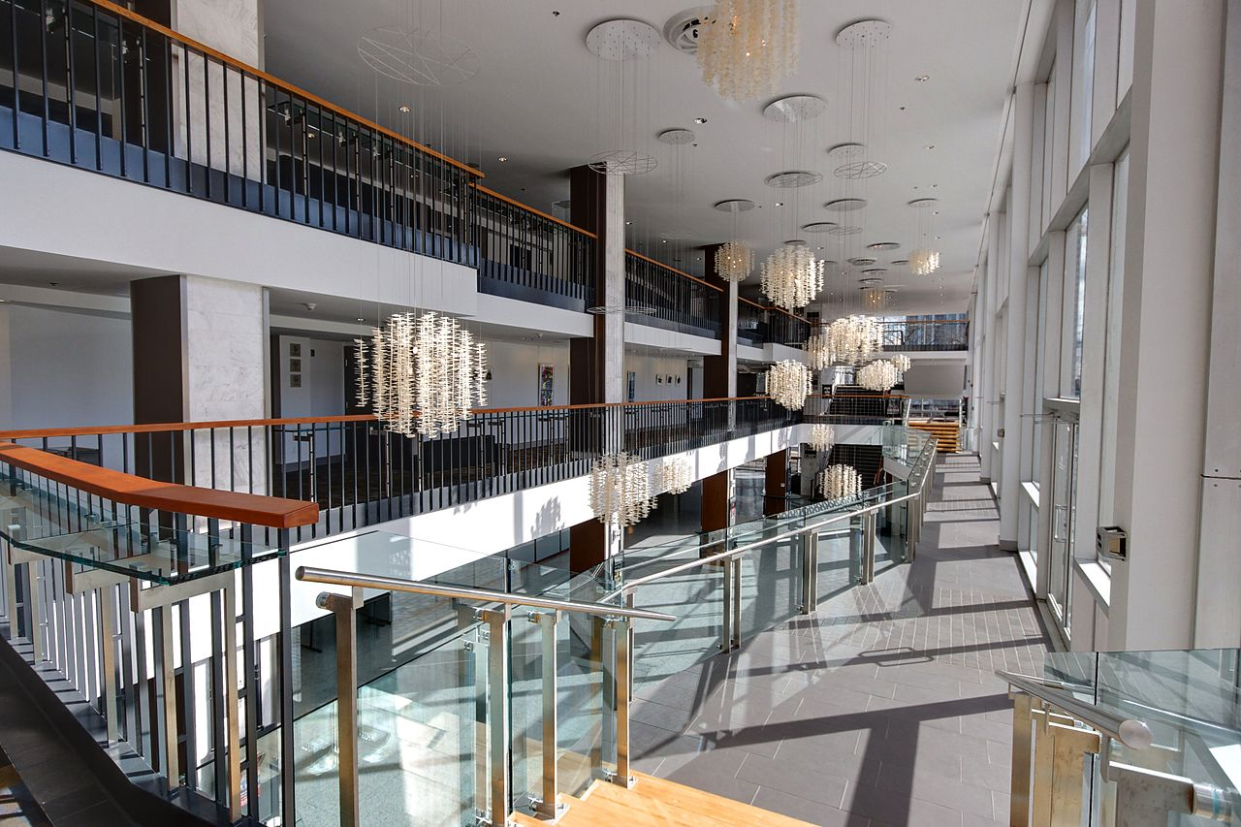

Slide 29
Processional
Around 6:20(ish), you’ll be told to get into your rows. At that point, you need to get in your spot and stay there.
Around 6:30(ish), we’ll walk down the stairs and wait outside the Door 4 of the theatre.
Stay in order and FOLLOW THE PERSON IN FRONT OF YOU.
EXCEPTION:
ROW CAPTAINS, FOLLOW THE LAST PERSON IN THE PREVIOUS ROW.

Slide 30
Processional cont’d
I will lead you into the theatre…UNTIL WE GET TO THE SEATS…
Then, ROW C WILL TAKE THEIR SEATS IN ROW C (the first row) and proceed to the furthest seat at the end of that row
ROW D CAPTAIN WILL BREAK OFF AND ENTER ROW D (the second row)
ROW 1 CAPTAIN WILL BREAK OFF AND ENTER ROW 1 (the third row)
And so on and so on

Slide 32
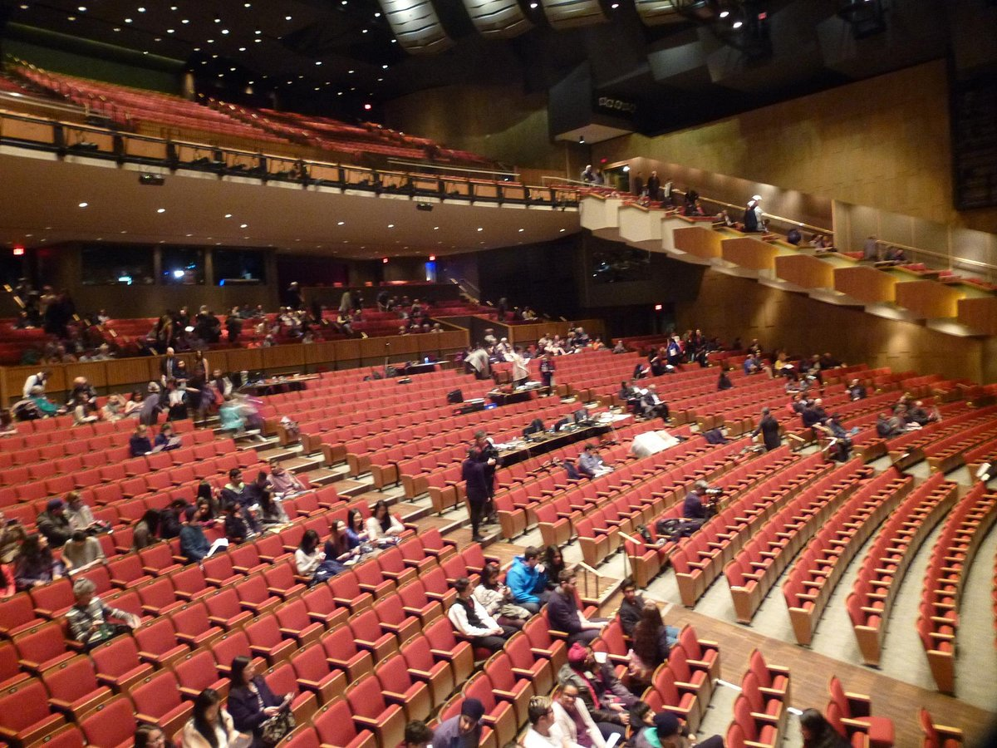

Slide 33
When it’s time to “walk”… (we’ll practice this with the first row in a few minutes)
Row captain will get a tap on the shoulder
Exit left through side door near stage into lobby (you’ll be led by a staff member)
You’ll make your way backstage (staying in line) and get your folder
We’ll make sure your hat, tassel, hood, etc. are all good before you head out on stage

Slide 34
Processional cont’d
RIGHT NOW, take a moment to meet and/or familiarize yourself with:
Who is in front of you (Row Captains: who is at the end of the row before you?)
Who is in front of the person in front of you (in case the person in front of you is away)—if you are behind a row captain, you’ll become a row captain, so know who is at the end of the previous row, too
If someone is away, LEAVE A SPACE FOR THEM (today AND for the real thing)

Slide 35
Processional cont’d
The order you are in affects the entire script.
If you’re not where you’re supposed to be, the wrong name and message could get read out.
DO NOT, FOR ANY REASON, SWITCH PLACES OR CHANGE THE ORDER.
If anything is not as it should be, (i.e. someone is missing, you think you’re in the wrong spot for some reason, etc.):
LET US KNOW AT SIDE STAGE.

Slide 36
When you get to the gym today
On your seat will be a plastic bag containing your grad attire and an envelope containing all of your tickets
Handle with care as they had to be opened to add your tassle and hood (they are NOT sealed)
WHEN REHEARSAL IS OVER AND AFTER YOU LEAVE THE GYM, please verify the contents, especially that you have a gown, hat, hood, and tassel.
If you are missing tickets you think you bought, or need more tickets to the ceremony, please see me or message me on Teams. DO NOT go to the office.

Slide 37
QUESTIONS?

