Slide 1
Grad season!
What you need to know

Slide 2
Shape of the hour(ish)
Overview of grad events
Action items for the events (stuff you’ve gotta do between now and then)
Valedictorian “trailers” and vote

Slide 3
Grad events
1. Ceremonies
2. Dinner/dance
3. Dry grad

Slide 4
Grad ceremonies
Tuesday, may 30 @ queen Elizabeth theatre
5:45 arrival time for grads; outside doors for families, etc. @ 6:00; 7:00 start
Usually lasts a bit over 2 hours
Recommend heading down early to avoid traffic, find parking, maybe eat something?
We’ll talk more about these logistics at the rehearsal

Slide 5
Grad ceremonies cont’d
Each student will receive 8 tickets (at the grad rehearsal breakfast), plus one for THEMselves
If you do not need all 8 tickets, please return extras to mr. clutchey
If you need more than 8 tickets, ask your friends, and if they can’t help you, please see mr. clutchey
Mandatory rehearsal Tuesday, may 23 @ 7:30 a.m. in the rotunda (stop whining, we feed you breakfast): super important that you are there

Slide 6
Action item: grad message
Includes your name (and phonetic pronunciation if your name is tricky), pronouns:
i.e. Drew clutchey (kloo-chee) he/him
Also includes brief message that is read as you walk across the stage
Biggar and Oldham will be reading these

Slide 7
How do I do this?
It is an “assignment” on the thss grad ceremony message 2023 teams page
Due before Monday, may 8 (one week)
It’s not optional; I neeeeeeeeed this to be done
Write in third person
Keep it brief (1-2 sentences max; it’s not an Oscars acceptance speech)
Keep it classy– people’s grandmas are there
usually, people thank who they want to thank
Maybe something about what you’re doing next year

Slide 8
Grad dinner & dance
Friday, june 9 @ meadow gardens
6:00 arrival time; dinner at 7:00
Each student that bought a ticket will receive it at grad rehearsal
Please do family photos, etc. prior to arrival
parents/families are to drop off only: room at the venue and parking are scarce
We’ll talk more about these logistics at the rehearsal

Slide 9
Action item: guest form (if applicable)
If you are intending to bring a guest who is not a part of the thss grad class, you need to submit a guest form (available in the office) and return by May 5

Slide 10
Action item: Grad dinner & dance table sign-up
Will take place starting Tuesday, may 16 at lunch in the languages area
10 to a table; you are only allowed to sign yourself up (and your out-of-school guest, if you have one)
No drama; figure it out
If you have a large friend group, consider breaking into smaller groups
It’s only where you are sitting just prior to, and during, dinner. You can move wherever you want before and after this. Calm down.

Slide 11
Table sign up, cont’d
In order to be allowed to sign up for a table, you must have:
All Grad fees paid
Guest form approved (if applicable)

Slide 12
Dry grad
Friday, June 9 @ 11:30 at thss
Doors close @ TBD
Event ends at 4:00 am
Have a safe way home
Waiver form for bull/surfboard
Dress comfortably

Slide 13
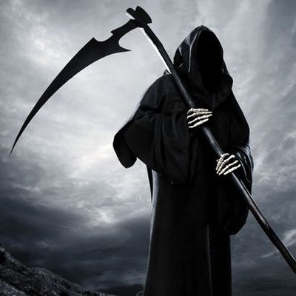
Marks cutoff
If you want to participate in the grad ceremonies, You must be comfortably passing all courses required for grad by
Friday, may 19

Slide 14
Review of action items
Grad message (may 8)
Guest forms (may 5)
Sign up for dinner tables (may 16)
Waiver forms for dry grad bull/surfboard (tbd)
Your work so that you’re comfortably passing everything by may 19

Slide 15
Valedictorian Time!

